Slide 1
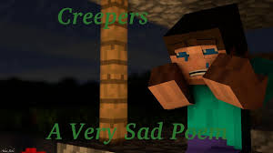
The 4th poam
It is about the Sadly a Minecraft Poem.

Slide 2
Sadly a Minecraft Poem
One sad day in Minecraft,
a creeper was at the door.
Zombies, spiders, skeletons,
and oh so much more.
I had no armor, I had no sword,
all I really had was a huge downpour.
But all the mobs just broke through.
I had to think, but that I couldn’t do.
I soon got creamed by the mobs at the door,
and I was there no more, no more.

