Slide 1
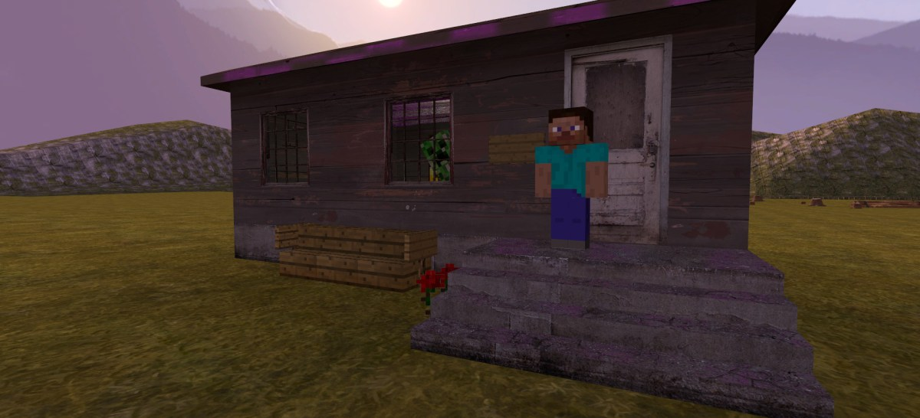
The 3ed poam
It is about the Creeper
at the Door

Slide 2
The Creeper at the Door
One night I heard a hissing sound
that was close behind the door.
It was scary, very scary,
this hissing sound came more!
I started thinking what it was
but soon I thought no more.
I went outside with a fake foam sword
but then it went . . . KABOOM!

