Slide 1
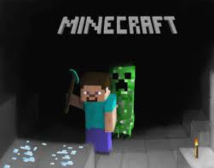
The 2^{ED} poam
It is about the Minecraft Turn Around in a Cave.

Slide 2
Minecraft Turn Around in a Cave
One day I was mining in a cave for some ore,
I was going to find something – of that I was sure.
So I found Lapis, I found gold, red stone (no problem), coal was easy
All I really want now is diamonds (it is not breezy).
But wait, what is that shiny blue ore?
I found diamonds, not one but more!
But then as I went to mine this wonderful ore,
A creeper snuck up behind me, and I was there no more.

