Slide 1
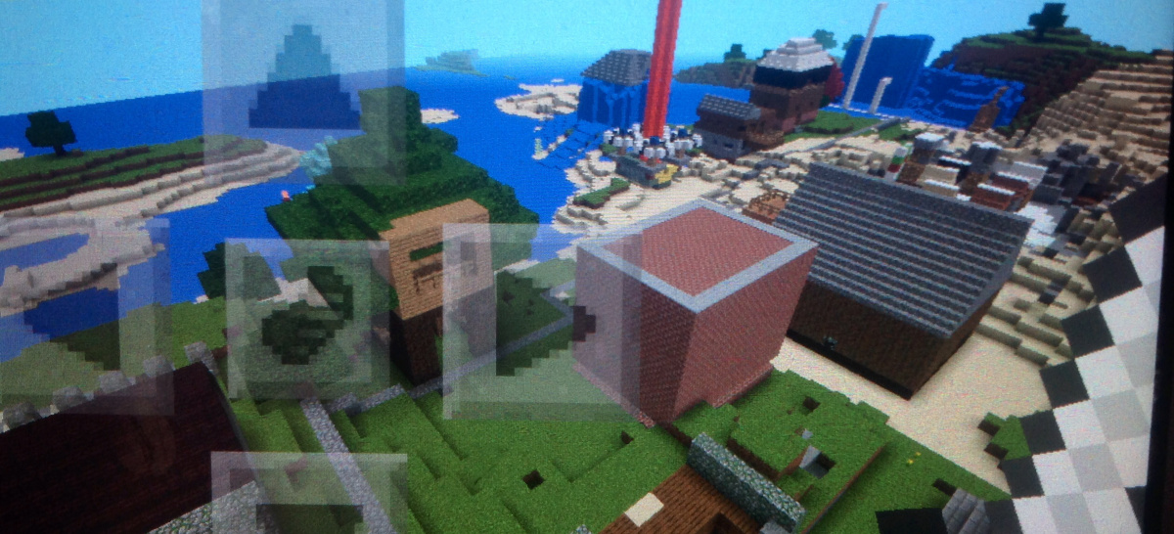
The 1st poam
It is about the mincraft
zomibi

Slide 2
My Minecraft Land poem
My Minecraft Land has a big, mossy tree fort.
It has a water park, too, with slides big and short.
I built a hidden maze inside a water fall.
I also have a party room, where I have a ball!
Next to my mansion, there is a cemetery,
Down deep underground, it is very scary.
I have a town that’s snowy and cold.
There’s a pyramid on water made of diamond and gold.
In the middle of my land, there’s a huge power source,
And everybody’s houses, including mine of course!

